Slide 1
REQUIREMENT ENGINEERING

Slide 2
Lesson 3: Requirement Elicitation

Slide 3
Previously…
Requirements Engineering Process
The 5 requirements engineering phases
Challenges faced during the requirements engineering process

Slide 4
Chapter Outlines
Introduction to Requirement Elicitation
Importance of Requirement Elicitation
Stakeholders and Sources of Requirements
Techniques for Requirement Elicitation
Challenges in Requirement Elicitation
Best Practices for Effective Requirement Elicitation
Conclusion

Slide 5
Learning Objectives:
Understand the concept and significance of requirement elicitation in software development.
Identify key stakeholders involved in the elicitation process.
Apply various requirement elicitation techniques effectively.
Recognize and address common challenges in requirement elicitation.
Implement best practices to improve requirement elicitation outcomes.

Slide 6
1. Introduction
elic·​it (i-ˈli-sət) verb: to draw out a response or a reaction from someone with skill. For example: “The video elicited strong emotional reactions”.
Not to be confused with illicit which means illegal.

Slide 7
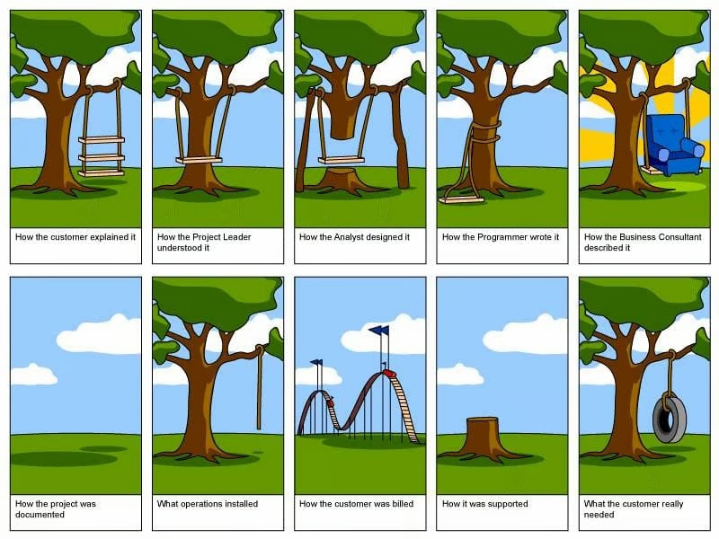
1. Introduction
elic·​it (i-ˈli-sət) verb: to draw out a response or a reaction from someone with skill. For example: “The video elicited strong emotional reactions”.
Not to be confused with illicit which means illegal.

Slide 8
1. Introduction
Requirement elicitation is the process of gathering, identifying, and understanding the needs and expectations of stakeholders for a system or software project.
It is a crucial step in Requirement Engineering, as poorly elicited requirements can lead to project failures, increased costs, and stakeholder dissatisfaction.

Slide 9
2. Importance of Requirement Elicitation
Ensures the system meets stakeholder expectations
Helps in defining clear and achievable project goals
Reduces project risks and costly rework
Improves communication among stakeholders and development teams

Slide 10
3. Stakeholders and Sources of Requirements
Customers and End-Users: Individuals interacting with the final product
Project Managers: Oversee project planning and execution
Software Developers: Design and implement the system
Regulators & Compliance Officers: Ensure adherence to industry standards

Slide 11
3. Stakeholders and Sources of Requirements
User representatives and many other stakeholders
Documentation about business processes, current systems, and competing products
Laws, regulations, and business policies
Existing systems, which may or may not be documented
User problem reports, help desk records, and support staff

Slide 12
4. Techniques for Requirement Elicitation

Slide 13
4.1. Interviews
Interviews involve direct discussions with stakeholders to gather insights into their needs, expectations, and constraints. Interviews can be:
Structured: Predefined set of questions
Unstructured: Open-ended discussions
Semi-Structured: A mix of structured and open-ended questions

Slide 14
4.2. Surveys & Questionnaires
Surveys help in collecting data from a large number of stakeholders using predefined questions. Useful for:
Gathering opinions and feedback
Identifying common trends and patterns

Slide 15
4.3 Workshops
Workshops bring together multiple stakeholders to discuss and refine requirements collaboratively. It includes:
Brainstorming sessions
Joint Application Development (JAD) meetings
Prototyping demonstrations

Slide 16
4.4 Observations
This involves directly watching users interact with existing systems to understand their workflow, pain points, and improvements needed.
Reasons for using this technique:
Direct User Interaction: Observing real-time user behavior to identify usability issues.
Workflow Analysis: Understanding how tasks are performed and identifying inefficiencies.
Unbiased Data Collection: Capturing actual user interactions without relying on self-reported feedback.

Slide 17
4.4 Observations
Identifying Hidden Requirements: Discovering implicit needs that users may not articulate.

Slide 18
4.5 Document Analysis
Reviewing existing documentation such as business reports, previous project records, and user manuals to extract relevant requirements.
Reasons for using this technique:
Historical Data Review: Analyzing past project documents to identify previously defined requirements and lessons learned.
Standard Compliance: Ensuring that requirements align with industry regulations and standards.

Slide 19
4.5 Document Analysis
Gap Identification: Detecting missing or inconsistent information that needs clarification.

Slide 20
4.6 Prototyping
Creating a working model of the system to gather feedback from stakeholders and refine requirements based on their input.
Main activities:
Designing Initial Mockups: Creating wireframes or sketches to visualize system components.
Developing a Functional Prototype: Building an interactive model with core functionalities.
Gathering Stakeholder Feedback: Testing the prototype with users to collect insights and suggestions.

Slide 21
4.6 Prototyping
Iterative Refinement: Modifying the prototype based on feedback to improve usability and functionality.

Slide 22
4.7 Use Cases
Defining various scenarios in which the system will be used, outlining actor interactions and expected outcomes.
Main activities:
Identifying Actors: Determining the primary users and external systems interacting with the system.
Defining Use Cases: Documenting different interactions and functionalities the system must support.

Slide 23
4.7 Use Cases
Creating Use Case Diagrams: Visually representing actor-system interactions for clarity.
Validating Use Cases: Reviewing with stakeholders to ensure completeness and accuracy of system requirements.
Sample Use Case: Use Case Template
I want to <do something>
As a <type of user>, I want to <perform some task> so that I can <achieve some goal>. (User Stories)

Slide 24
5. Challenges in Requirement Elicitation
Ambiguous Requirements: Stakeholders may provide vague or conflicting requirements.
Changing Requirements: Business needs evolve, leading to requirement modifications.
Stakeholder Conflicts: Different stakeholders may have opposing expectations.
Limited User Involvement: Poor engagement from end-users may result in incomplete requirements.

Slide 25
6. Best Practices for Effective Requirement Elicitation
Engage all relevant stakeholders early and consistently.
Use multiple elicitation techniques for comprehensive data collection.
Clearly define scope and objectives before elicitation begins.
Validate and verify requirements with stakeholders regularly.
Document requirements systematically to avoid misinterpretations.
Notes:
You will miss non-functional requirements here but at least you know what the user needs and this helps not to create unnecessary features.

Slide 26
7. Conclusion
Requirement elicitation is a foundational phase of software development and requirement engineering.
Employing the right techniques and engaging stakeholders effectively ensures a high-quality system that aligns with user needs and business goals.
By overcoming challenges through best practices, organizations can reduce project risks and improve software success rates.

Slide 27
References
“elicit,” Merriam-Webster Dictionary. Jun. 15, 2026. [Online]. Available: https://www.merriam-webster.com/dictionary/elicit

